Slide 1
CATEGORIES COMPARISON CASES
@EINARWH
Notes:
Hi everyone! This is the title of my talk, and sort of also the agenda. We will be talking about categories, comparison and cases. Which is to say, we will look at how we use these things, these tools, to try to make sense of the world or the domain we operate in. Which is to say, we will be talking about modelling.

Slide 2
ME
Notes:
A few words about me. I have been making software for twenty years. Most of my career I have been writing code. Very recently I have started working as a socio-technical advisor the Norwegian Labour and Welfare Administration. NAV is a large organization. We administer a third of the national budget through schemes such as unemployment benefit, work assessment allowance, sickness benefit, pensions, child benefit and cash-for-care benefit. And we have

Slide 3

Notes:
A few words about me. I have been making software for twenty years. Most of my career I have been writing code. Very recently I have started working as a socio-technical advisor the Norwegian Labour and Welfare Administration. NAV is a large organization. We administer a third of the national budget through services such as unemployment benefit, work assessment allowance, sickness benefit, pensions, child benefit and cash-for-care benefit. And we have a lot of categories.

Slide 4
CATEGORY THEORY

Slide 5
CATEGORY PRACTICE

Slide 6
HELLO FELLOW APES
Notes:
I needed a way to introduce the topic that I want to discuss today, and this is what I came up with. Hello fellow apes! And what I’m going for here, is some sort of reaction to that statement. I’m interested in the neurons being fired in your brains.

Slide 7
HELLO FELLOW HUMANS
Notes:
Of course I could have said something like this instead, but it would have been less interesting, I think. It would have sounded almost normal, something that Mark Zuckerberg might say to blend in.

Slide 8
HELLO FELLOW SENTIENT BEINGS
Notes:
Or hello fellow sentient beings, perhaps. That would make you suspect that I might be an octopus or a cephalopod.

Slide 9
HELLO FELLOW OBJECTS
Notes:
You couldn’t possibly object to this, since we all know that the object is the superclass of all other things. But of course, it would be very vague, since I would also be greeting the chairs you’re sitting in, and everything else in the room.

Slide 10
HELLO FELLOW APES
Notes:
But I chose fellow apes, and the purpose was to be a little bit provocative, and to start us off with a little reflection.

Slide 11
IS IT A GOOD GREETING?
Notes:
Is it a good greeting?

Slide 12
IS IT REASONABLE?
Notes:
So to dig a little bit into those neural firings, let’s ask a few question. So first, is it a reasonable greeting do you think?

Slide 13
IS IT APPROPRIATE?
Notes:
Is it appropriate?

Slide 14
IS IT INSULTING?
Notes:
Is it insulting in some way?

Slide 15
IF SO, WHY?
Notes:
If so, then why is that?

Slide 16
DO WE AGREE THAT WE ARE APES?
Notes:
Maybe first we should settle this. Do we agree that we are apes?

Slide 17
WHAT IS AN APE?
Notes:
And to answer that, we need to think about what an ape is. Or perhaps rather, what the category of apes is. What does it mean to belong to the category of apes?

Slide 18
APE (TECHNICAL)
Notes:
Technically, apes form a clade of animals with a common ancestor. This approach to classification is known as cladestics, and it’s how we currently categorize species.

Slide 19
IS-A
HUMAN
APE
Notes:
Technically, then, there is no doubt. We can say precisely what a human is and what an ape is, and there is an is-a relationship between the two categories. Nothing more to discuss.

Slide 20
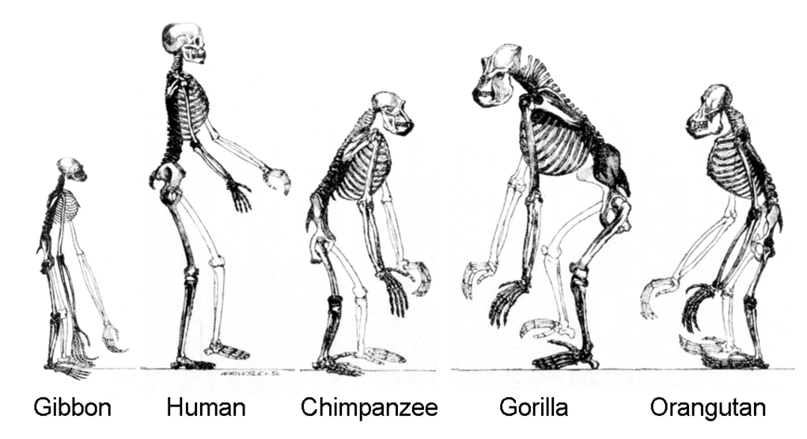
Notes:
Here we are in good company at the family reunion. We even got flanked by a gibbon, so we can’t easily escape the party. This is us, the human ape and our relatives.

Slide 21
WE ARE THE MOST COMMON APE
Notes:
In fact, we are by far the most common ape on the planet.

Slide 22
1 : 26000
Notes:
This is the chimpanzee-to-human ratio in the world, by the highest estimated number of chimpanzees, which is 300000. For every chimpanzee, there are 26000 humans. So it’s not even a competition. Almost every ape is a human ape.

Slide 23
A HUMAN IS JUST A HOMINID IN THE CATEGORY OF SIMIANS, WHAT’S THE PROBLEM?
Notes:
So we can’t really protest too much. A human is just a hominid in the category of simians.

Slide 24
TYPICALITY
Notes:
The problem, I think, has to do with typicality. We might be the most common ape, but we are definitely not the most typical ape. Which is perhaps.a little bit surprising and a little bit striking. But it’s actually not unique. We have the same situation for birds. A few years ago I did a talk where I argued that the sparrow is the most typical bird there is, but it’s not the most common bird. By far the most common bird is the chicken, which can’t even fly properly. It’s a pathetic bird. But humans like to eat chicken, so there’s a lot of them.

Slide 25
YES WE ARE TECHNICALLY APES BUT
Notes:
While we have more or less grudgingly come to accept that we belong to the same group as the other animals that we call apes, we don’t think of ourselves as typical apes. We’ve seen the diagrams, we’re seen the family picture, but we don’t feel like we belong.

Slide 26
WE DON’T USUALLY THINK OF OURSELVES AS APES
Notes:
We don’t think of ourselves as apes most of the time.

Slide 27
WE ARE PRIMARILY HUMAN
Notes:
Instead, we think of ourselves as human.

Slide 28
REASONS! EVIDENCE!

Slide 29
NOT HAIRY ENOUGH
Notes:
First of all, we’re not hairy enough. Typical apes have more hair on their bodies than we do.

Slide 30
TOO UPRIGHT
Notes:
We are too upright to be a typical ape. We walk on two feet.

Slide 31
NOT LONG ENOUGH ARMS
Notes:
Our arms are too short.

Slide 32
WEAK FOOTGRIP / POOR CLIMBER
Notes:
We have relatively weak footgrip. We are poor climbers. We are better suited to a life on the ground than a life up in the treetops. Some of us are afraid of heights.

Slide 33
TOO INTELLIGENT
Notes:
We are much too intelligent to be considered a typical ape. We have even labeled ourselves, not too modestly, as the wise ape, homo sapiens.

Slide 34
NOT QUITE FOND ENOUGH OF BANANAS
Notes:
And of course, even though we might eat the occasional banana, the typical ape – in our perception – is much more of a banana-holic. We can easily picture a chimpanzee or a gorilla chain-eating a whole bunch of bananas.

Slide 35
BANANAS?
Notes:
Which turns out to be wrong. Bananas distinguish humans from the other apes in that we eat more of them.

Slide 36
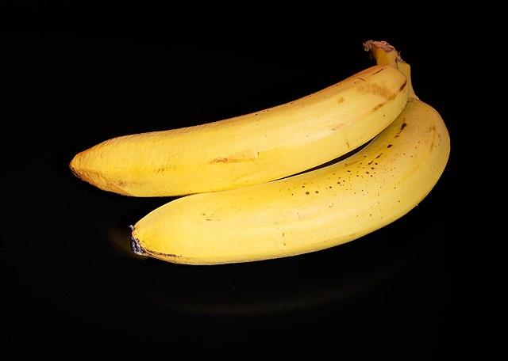
Notes:
Typically when we talk about bananas, we mean the cultivated banana known as the Cavendish banana. It is a domesticated plant that the other apes can only get from us. We are the banana-dealers of the animal kingdom. Apes will eat bananas, but actually prefer grapes.

Slide 37
NOT QUITE FOND ENOUGH OF BANANAS
Notes:
So we ended up here.

Slide 38
WE ARE DIFFERENT
Notes:
But it doesn’t matter. To summarize. We are different somehow. Yes, there are similarities, but also so many differences that ape feels like a poor label for us.

Slide 39
APE (CASUAL)
Notes:
In fact, you could say that there’s another notion of ape out there, that is *not* technical, and it is not designed to be precise. It is casual and informal. And in that category, we don’t really fit all that well.

Slide 40
SO ARE WE APES OR NOT?
Notes:
So the question then becomes, are we apes or not? This is very confusing! We know that technically, we are apes, but we don’t feel like apes. It doesn’t feel like our identity.

Slide 41
DIFFERENT CONTEXTS
BIOLOGY (TECHNICAL)
EVERYDAY (CASUAL)
APE AS HOMONYM
Notes:
But it’s not really that difficult. What we have are two different contexts, and two different categories, denoted by the same word, APE. In biology, we have a technical category of APE, which unambivalently includes humans. There is no discussion about it. We share the same common ancestor. By definition, we are apes. In the everyday category of ape, however, things are more blurry. We know, intellectually, since Darwin, that we are apes. But our membership is fuzzy and problematic. We’re an edge case. Often we think of ourselves outside the ape category, and require that apes be hairy climbers.

Slide 42
WE ARE CONFUSED
Notes:
But still we are confused, and the reason is that we don’t distinguish between the contexts. We don’t even know that we should distinguish between the contexts. In fact, an interesting question might be, should we distinguish between these contexts? Or is the everyday category just wrong, and we should adopt the category used in biology? Would that solve our problems?

Slide 43
HOW APE ARE WE?
Notes:
We’ll get back to that. In the meantime, we might ask ourselves, how ape are we?

Slide 44
👏
Notes:
If all goes well, and you are a polite audience, this session might end by you as a group clapping. Which is to me the perfect example of human ape behavior. There is something very ape-like in clapping your hands together to make noise. And indeed other apes do clap their hands together, we’re not the only clapping ape. But other apes use it differently, for instance as a warning. We, however, are especially social-minded apes, and so we’re the only apes that have invented applause. So it very nicely captures our «human apeness»

Slide 45
Notes:
So that was the introduction. Where does that leave us?

Slide 46
WHAT IS A CATEGORY?
Notes:
Let’s start looking at categories a little more systematically now. What is a category?

Slide 47
WHAT DOES THAT EVEN MEAN?
Notes:
Well that’s an interesting question, but what does it mean?

Slide 48
WHAT IS A CATEGORY REALLY?
Notes:
So we might wonder what a category really is.

Slide 49
WHAT IS THE TRUE NATURE OF CATEGORIES?
Notes:
What is the true nature of categories?

Slide 50
AN IMPRACTICAL PERSPECTIVE
Notes:
That would be an impractical and theoretical perspective, which we could only speculate about. It’s like debating the nature of celestial beings. It’s not even clear that there is any such thing as «true nature».

Slide 51
PRACTICAL PERSPECTIVES
Notes:
But there are more practical perspectives.

Slide 52
HOW IS A CATEGORY REPRESENTED IN THE HUMAN BRAIN?

Slide 53
WE DON’T KNOW

Slide 54
BUT WE HAVE SOME MODELS

Slide 55
ESSENSIAL PROPERTIES (CLASSICAL VIEW)

Slide 56
PROTOTYPICAL

Slide 57
EXEMPLAR

Slide 58
What are categories used for?
Notes:
We could ask, what are categories used for?

Slide 59
WHY ARE CATEGORIES USEFUL?
Notes:
Or perhaps even why are categories useful?

Slide 60
SENSE-MAKING
Notes:
Categorization is a tool for sense-making, perhaps *the* tool for sense-making.

Slide 61
HOW WE ORGANIZE AND STRUCTURE INFORMATION ABOUT THE WORLD
Notes:
It’s how we organize and structure information about the world. Which is pretty important, since we find ourselves put into this world, and we can’t really escape it until we do. So while we’re here, being able to organize and structure information makes life easier.

Slide 62
THIS IS LIKE THAT THIS IS IDENTICAL TO THAT THIS IS ROUGHLY THE SAME AS THAT THIS IS DIFFERENT FROM THAT

Slide 63
COMPARISON, SORTING, CLASSIFICATION, DISTINGUISHING
Notes:
Well

Slide 64
ENABLES LANGUAGE
Notes:
It enables language. If everything were individual, ungrouped objects, they’d need unique names, and language would pretty useless.

Slide 65
ECONOMY OF THOUGHT
Notes:
Immediately we can say that categories are useful because they allow economy of thought.

Slide 66
EFFICIENT COMMUNICATION
Notes:
It also allows for economy of communication.

Slide 67
ENABLES INDUCTION
Notes:
Very importantly, it enables induction, right? So from my experiences with specific members of a category, I can create hypotheses about all or at least most members of the category.

Slide 68
ENABLES LEARNING
Notes:
At that in turn helps learning. It’s much easier to learn if we don’t need direct experience with every object in the world.

Slide 69
NAVIGATION, CHOICE, PLANNING, ACTION
Notes:
It enables navigation, choice, planning and meaningful action.

Slide 70
ENABLES US TO BE EFFECTIVE AGENTS IN THE WORLD
Notes:
In short, it enables us to be effective agents in the world.

Slide 71
CATEGORIZATION IN PRACTICE

Slide 72
CATEGORIZATION IS HILARIOUS

Slide 73
EVERYDAY CASUAL MODELLING

Slide 74
COARSE, IMPRECISE, PARTIAL

Slide 75
MOSTLY ADEQUATE

Slide 76
USEFUL

Slide 77
TO ACHIEVE GOALS

Slide 78
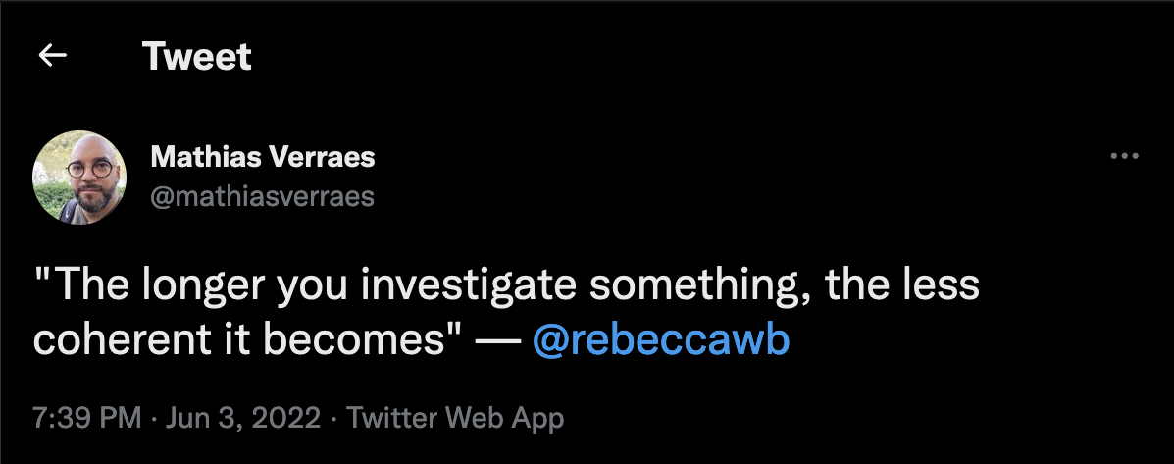

Slide 79
CATEGORY MEMBERSHIP

Slide 80
MEMBERSHIP EVALUATION
Notes:
Heuristics? Gut feeling?

Slide 81
NECESSARY AND SUFFICIENT?
Notes:
Heuristics? Gut feeling?

Slide 82
IS-A?

Slide 83
BOOLEAN VS RATING

Slide 84
EXAMPLES
Notes:
Heuristics? Gut feeling?

Slide 85
SOMETIMES IT’S EASY

Slide 86
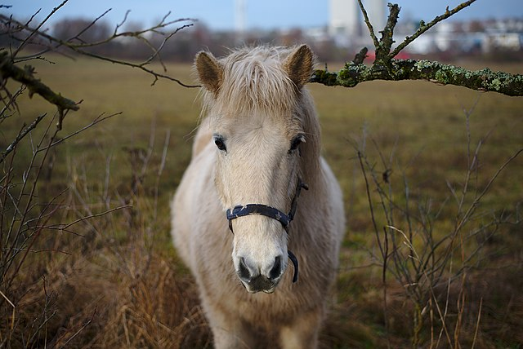
HORSE?

Slide 87
HORSE?
HORSENESS VERY HIGH

Slide 88
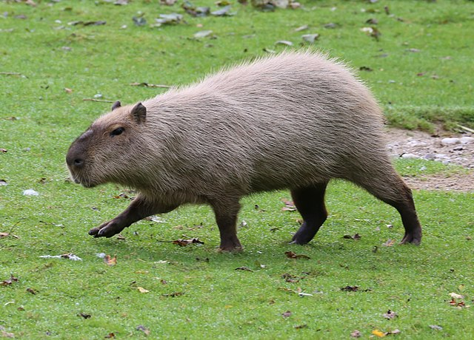
HORSE?

Slide 89
HORSE?
HORSENESS QUITE LOW

Slide 90
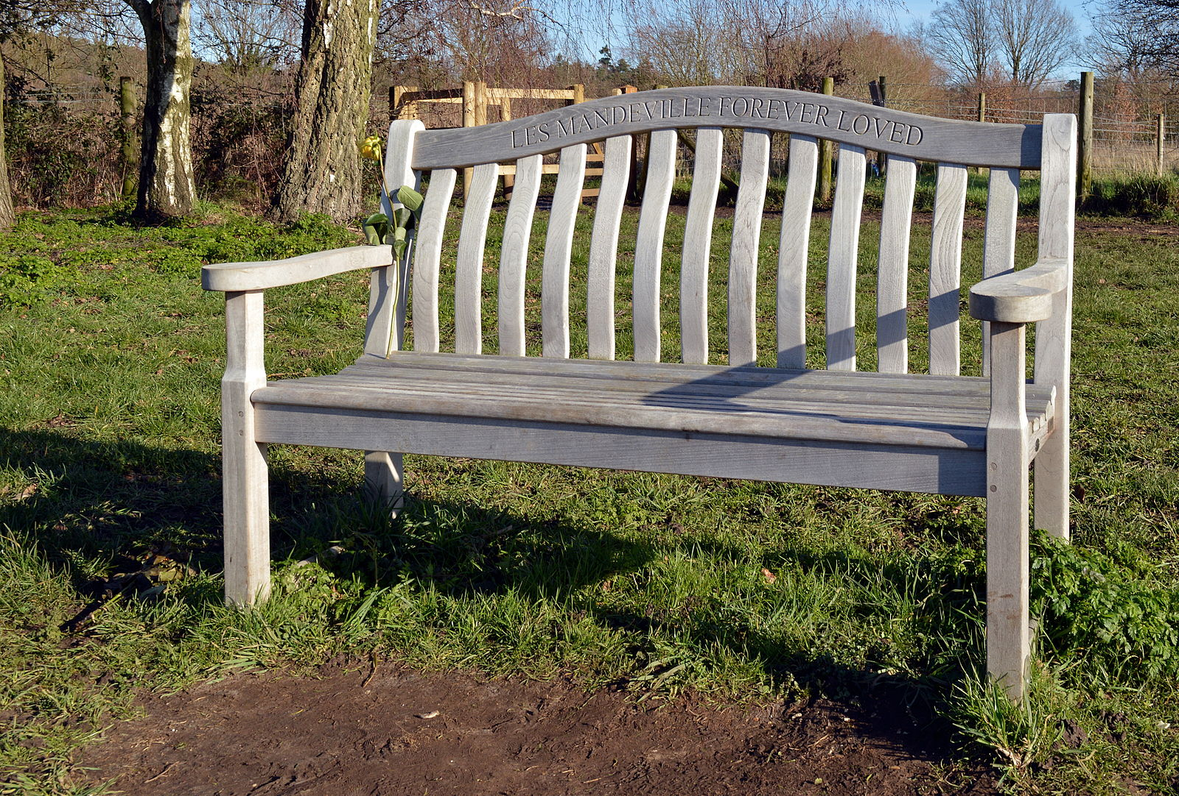
HORSE?

Slide 91
HORSE?
HORSENESS EVEN LOWER

Slide 92
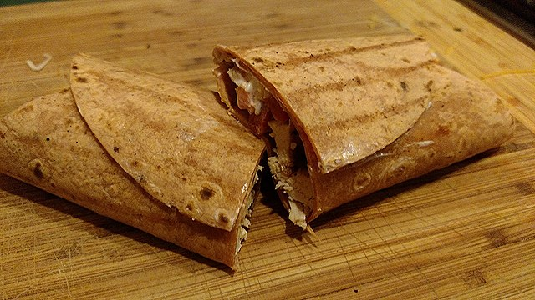
HORSE?

Slide 93
HORSE?
HORSENESS PRACTICALLY ZERO

Slide 94
SOMETIMES IT’S A LITTLE HARDER

Slide 95
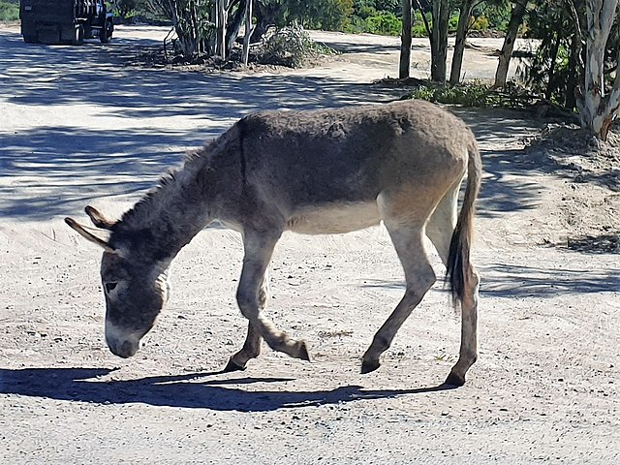
HORSE?

Slide 96
HORSE?
HORSENESS MEDIUM+

Slide 97
HORSENESS DEPENDS ON THE EXISTENCE OR ABSENCE OF OTHER CATEGORIES

Slide 98
DONKEYNESS SABOTAGES THE HORSENESS OF THE DONKEY

Slide 99
Notes:
Let’s try another.

Slide 100
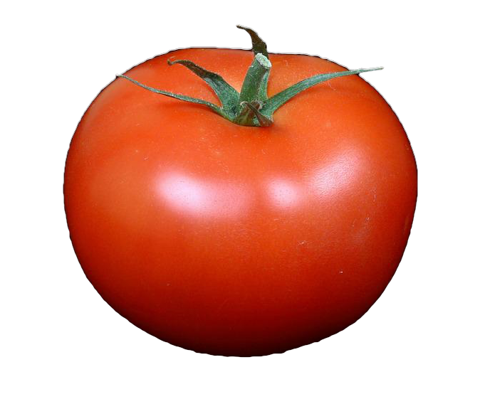
Notes:
What about this? These are tomatoes. What category do they belong to?

Slide 101
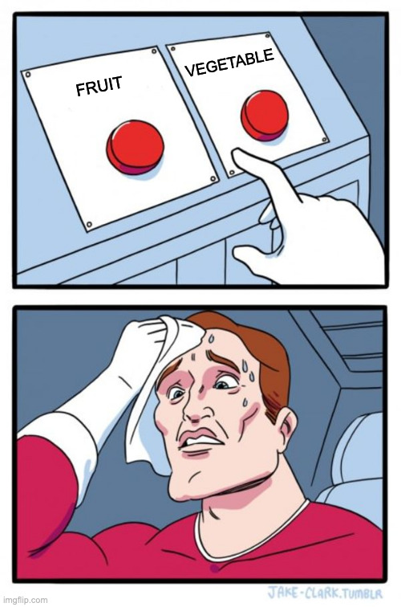
Notes:
What about this? These are tomatoes. What category do they belong to?

Slide 102
Notes:
What about this? These are tomatoes. What category do they belong to?

Slide 103
Notes:
To be honest, if you ask me, I’m going to say that a tomato is 70% vegetable and 30% fruit. This is my everyday casual categorization, and you’ll notice that I don’t really need to choose. But it’s mostly vegetable to me. I certainly would never put tomatoes in a fruit salad.

Slide 104
70% VEGETABLE
30% FRUIT
Notes:
To be honest, if you ask me, I’m going to say that a tomato is 70% vegetable and 30% fruit. This is my everyday casual categorization, and you’ll notice that I don’t really need to choose. But it’s mostly vegetable to me. I certainly would never put tomatoes in a fruit salad.

Slide 105
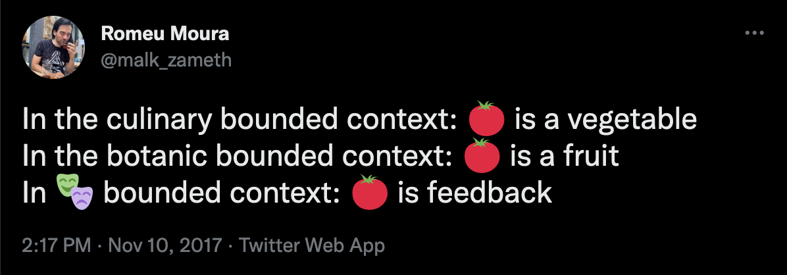
Notes:
Heuristics? Gut feeling?

Slide 106
CATEGORIES ARE CONTEXTUAL

Slide 107
CATEGORIES CAN BE FUZZY

Slide 108
DEGREES OF MEMBERSHIP

Slide 109
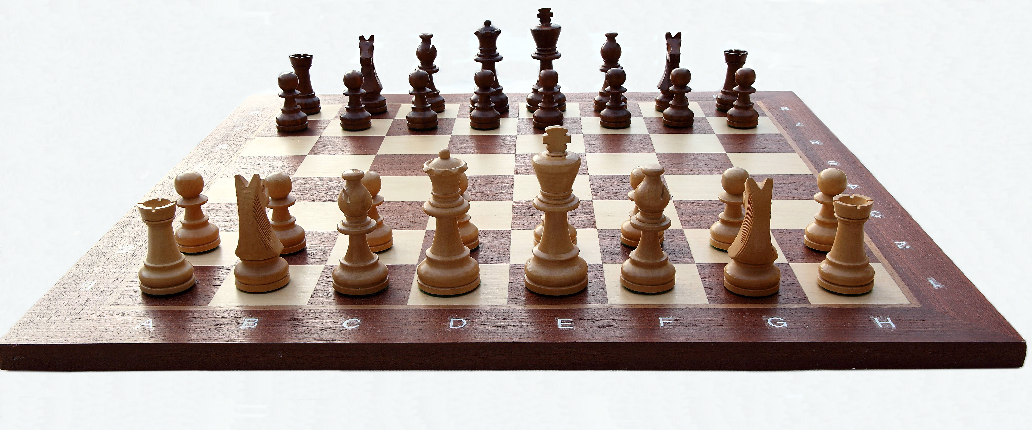

Slide 110
SPORT?

Slide 111
SPORT?
SPORT THAT IS ALSO A GAME

Slide 112
SPORT?
NOT A SPORT

Slide 113
RELATIONS BETWEEN CATEGORIES

Slide 114
TAXONOMIES

Slide 115
HIERARCHIES

Slide 116
GENERALISATIONS & SPECIALISATIONS

Slide 117
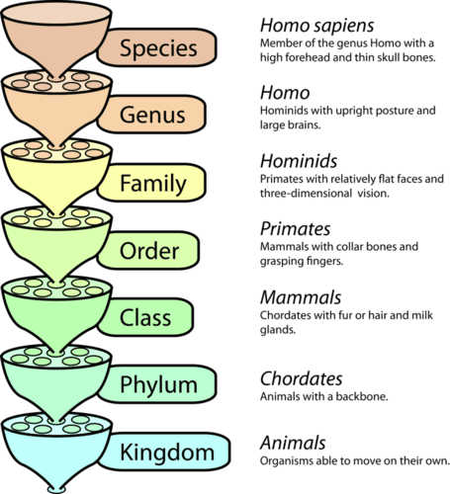

Slide 118
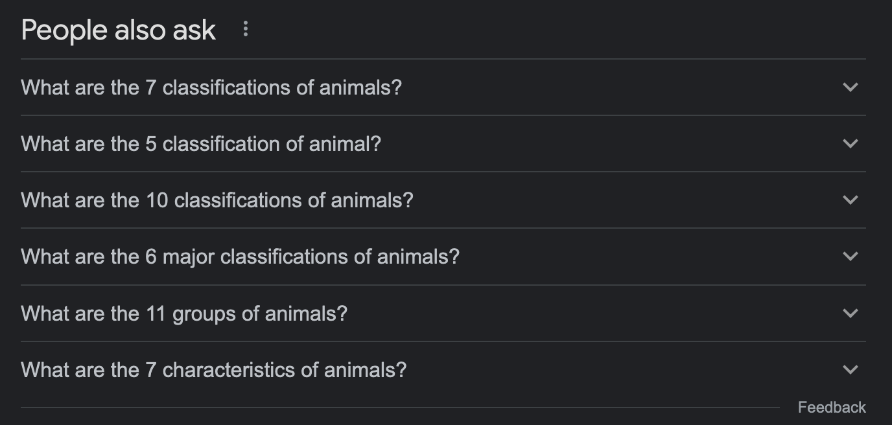

Slide 119
BASIC LEVEL CATEGORIES

Slide 120
BASIC LEVEL PREFERENCE

Slide 121
DIFFERENCE & INFORMATION

Slide 122
THIS IS AUTOMATIC

Slide 123
BASED ON UTILITY AND EXPERIENCE

Slide 124
DEPENDS ON EXPERTISE

Slide 125
CULTURE-SPECIFIC

Slide 126
BUT IT’S ALWAYS MORE COMPLICATED

Slide 127
EXPERIMENT

Slide 128
tEst

Slide 129
1
2
3

Slide 130
LET’S RUN THE EXPERIMENT!

Slide 131
PICTURE #1

Slide 132
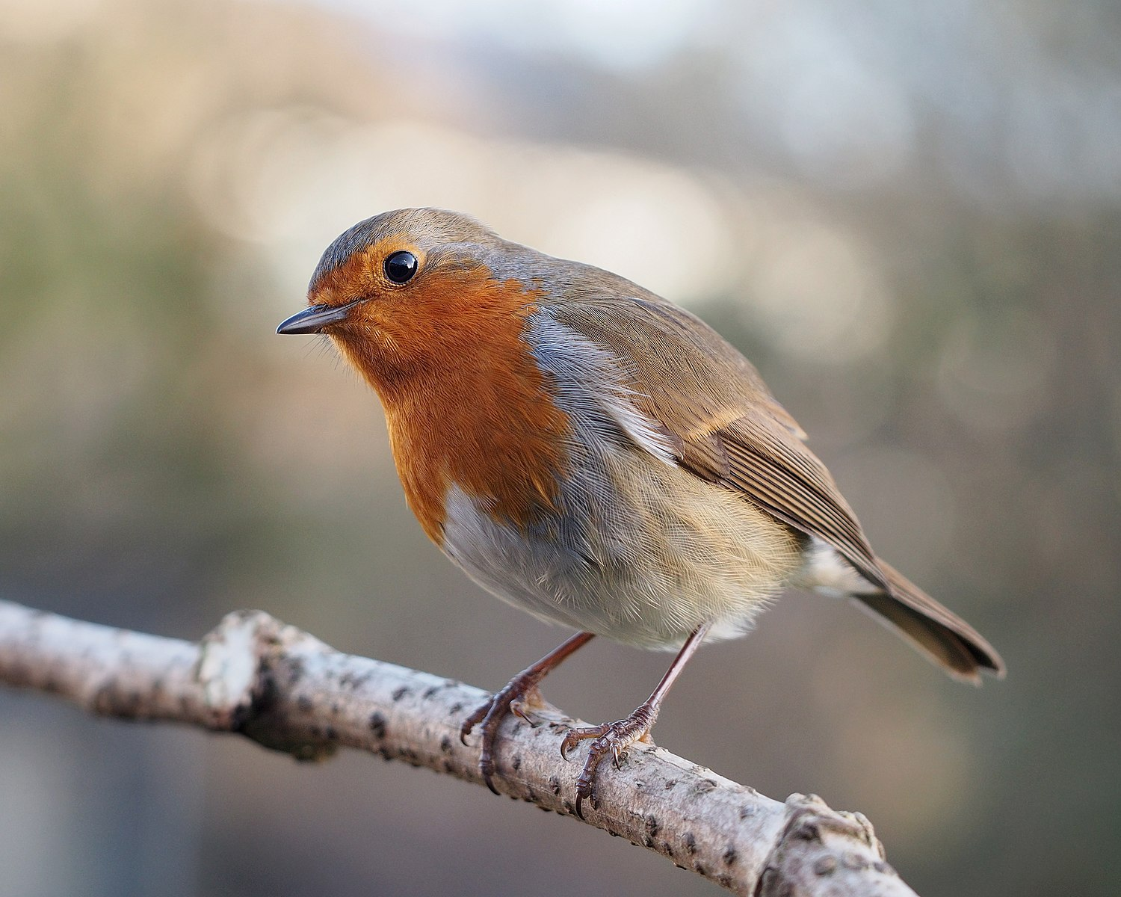
1
2
3

Slide 133
PICTURE #2

Slide 134
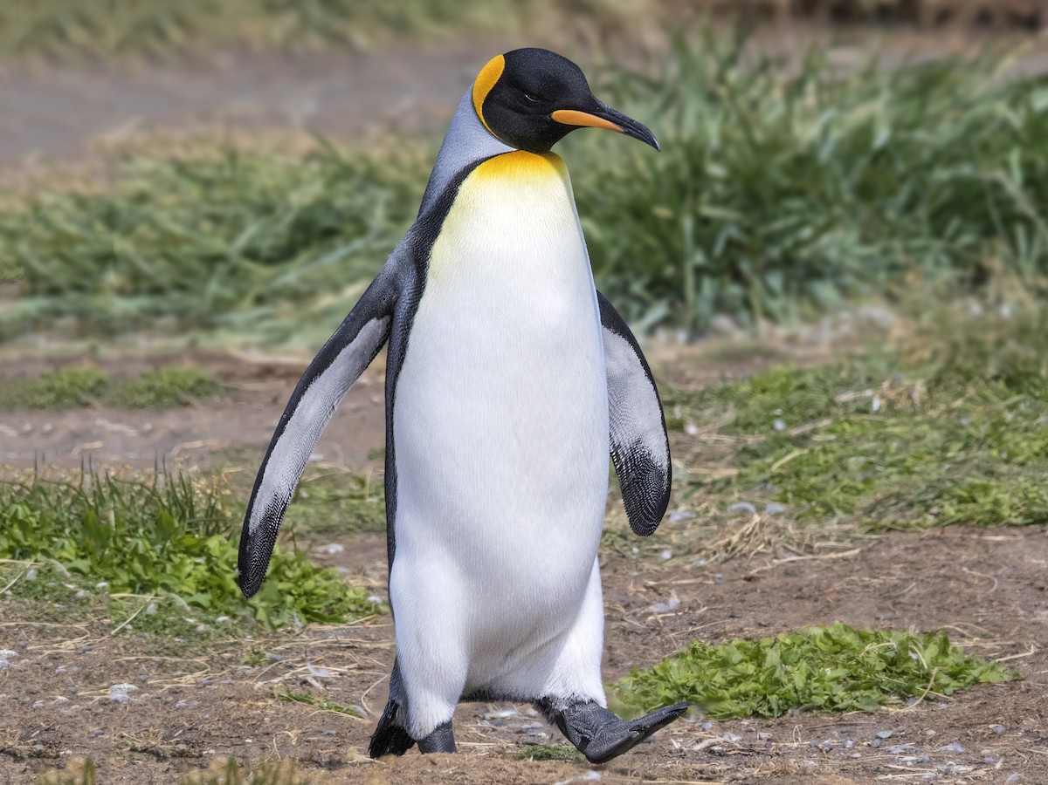
1
2
3

Slide 135
WHAT HAPPENED HERE?

Slide 136
A ROBIN IS A BIRD THAT HAPPENS TO BE A ROBIN

Slide 137
A PENGUIN IS A PENGUIN THAT HAPPENS TO BE A BIRD

Slide 138
ROBINS ARE TYPICAL BIRDS

Slide 139
PENGUINS ARE ATYPICAL BIRDS
Notes:
This actually has all kinds of interesting effects. For instance, if there’s a disease that affects robins, we’re more likely to assume that it affects all birds, than if there’s a disease that affects penguins.

Slide 140
TYPICAL CASES ARE CATEGORIZED AT THE BASIC LEVEL

Slide 141
ATYPICAL CASES ARE CATEGORIZED AT THE SUBORDINATE LEVEL

Slide 142
TROUBLE IN TAXONOMY TOWN

Slide 143
NON-TRANSITIVITY

Slide 144
A
IS-A
B
IS-A
C
IS-A

Slide 145
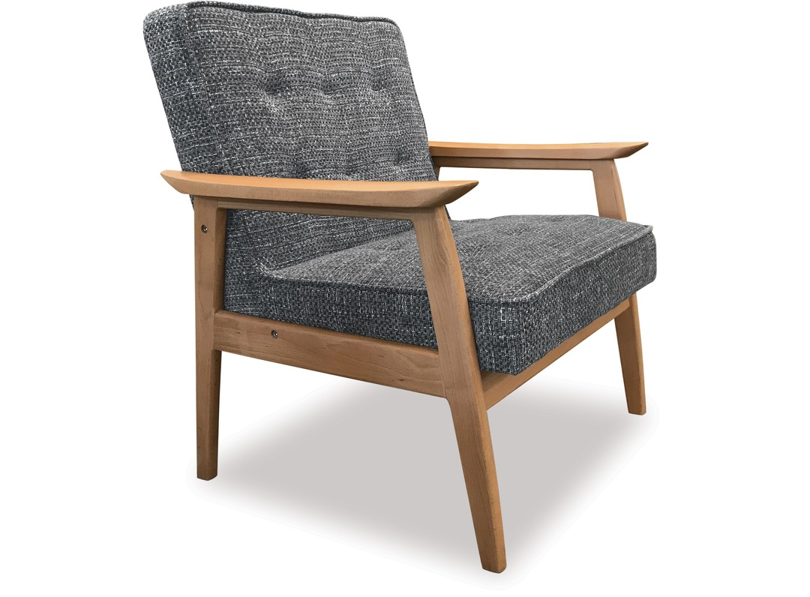

Slide 146
CHAIR IS FURNITURE?

Slide 147
CHAIR IS FURNITURE?
YES

Slide 148
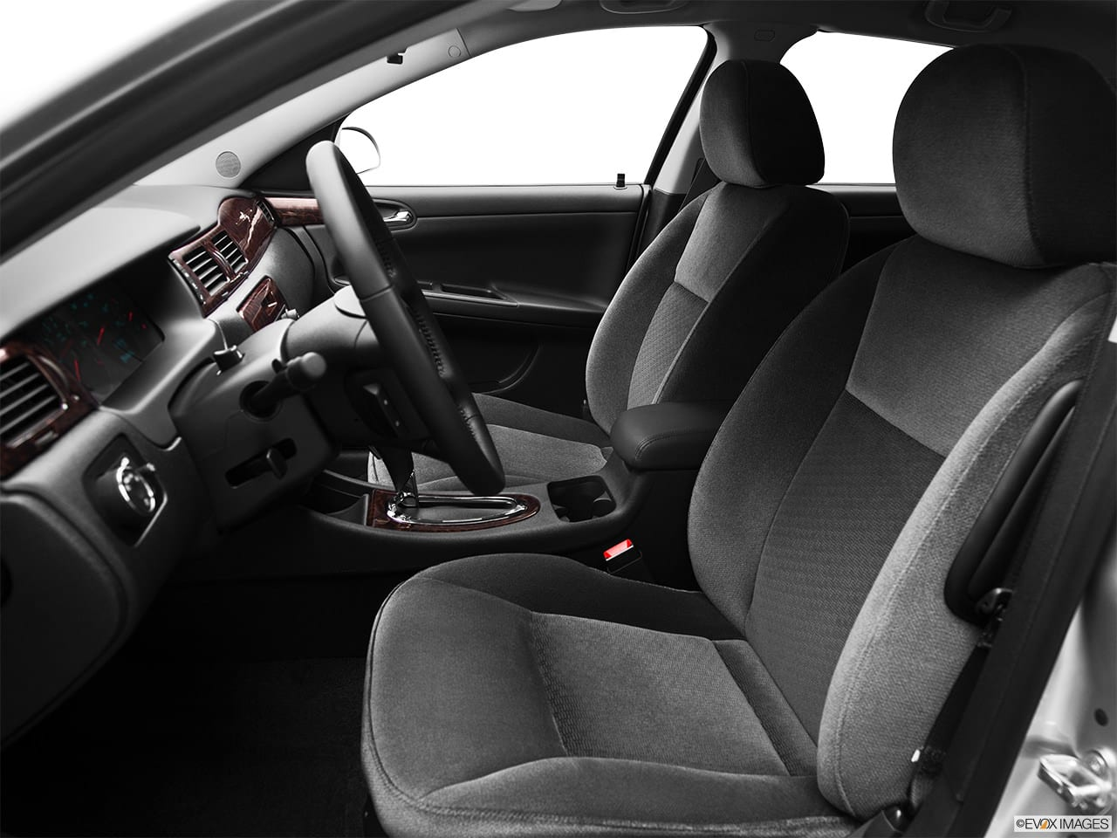

Slide 149
CAR SEAT IS CHAIR?

Slide 150
CAR SEAT IS CHAIR?
YES

Slide 152
CAR SEAT IS FURNITURE?

Slide 153
CAR SEAT IS FURNITURE?
NO

Slide 154
CAR SEAT
IS-A
CHAIR
IS-A
FURNITURE
IS-NOT-A

Slide 155
CATEGORIES ARE FUZZY

Slide 156
DEGREES OF MEMBERSHIP

Slide 157
EDGE CASES

Slide 158
NEGOTIATING CATEGORIES

Slide 159
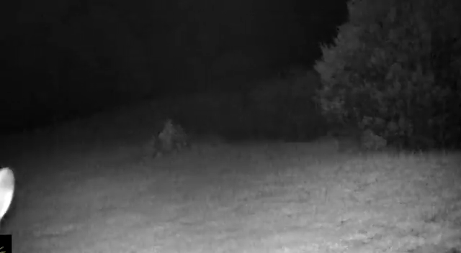

Slide 160
IS HTML A PROGRAMMING LANGUAGE?

Slide 161
DO WE WANT HTML TO BE A PROGRAMMING LANGUAGE?

Slide 162
DESCRIPTIVE VS NORMATIVE

Slide 163
THE PROBLEM IS NOT THE OBJECT BUT THE CATEGORY

Slide 164
CATEGORY DISCUSSION AS PROXY DISCUSSION

Slide 165
CATEGORY DEFINITION IS POWER OVER THE DOMAIN

Slide 166
WHAT ARE THE IMPLICATIONS?

Slide 167
PROS AND CONS

Slide 168
TRADEOFFS

Slide 169
MODELLING

Slide 170
MODELLING AS TECHNIFICATION OF CATEGORIES

Slide 171
ELIMINATING AMBIGUITY

Slide 172
HANDLING EDGE CASES

Slide 173
TECHNIFICATION OF CATEGORIES HAVE SURPRISING CONSEQUENCES

Slide 174
NUTS ARE FRUITS?!?

Slide 175
ALMONDS ARE NOT NUTS?!?

Slide 176
WE’RE WRONG ABOUT EVERYTHING!!!

Slide 177
BUT WE’RE NOT WRONG

Slide 178
CONTEXT

Slide 179
EVERYDAY VS TECHNICAL CATEGORIES

Slide 180
AMBIGUITY

Slide 181
TECHNICAL CATEGORIES FOR PRECISION

Slide 182
PRECISION COMES AT A COST

Slide 183
CATEGORIES AT NAV

Slide 184
VARIATIONS ON A THEME

Slide 185
UNMARRIED PEOPLE LIVING TOGETHER

Slide 186
TWO PEOPLE ABOVE 18 YEARS OF AGE WHO ARE NOT MARRIED, REGISTERED PARTNER OR LIVING WITH ANYONE ELSE

Slide 187
TWO PEOPLE WHO USUALLY LIVE TOGETHER EVEN IF THEY ARE TEMPORARILY SEPARATED

Slide 188
TWO PEOPLE LIVING IN THE SAME HOUSE, EVEN IF THEY LIVE IN SEPARATE PARTS OF THE HOUSE

Slide 189
[...] UNLESS THEY EACH LIVE IN SEPARATE UNITS IN A HOUSE WITH FOUR OR MORE INDEPENDENT AND CLEARLY SEPARATED UNITS

Slide 190
HAVE PREVIOUSLY BEEN MARRIED

Slide 191
LIVING TOGETHER IN A MARRIAGE-LIKE RELATIONSHIP

Slide 192
COULD LEGALLY GET MARRIED OR ENTER PARTNERSHIP

Slide 193
HAVE OR ARE EXPECTING CHILDREN TOGETHER

Slide 194
HAVE OR HAVE HAD CHILDREN TOGETHER

Slide 195
JOINT RESIDENCE

Slide 196
COMMON HOUSEHOLD

Slide 197
HAVE LIVED TOGETHER FOR AT LEAST 12 MONTHS

Slide 198
HAVE LIVED TOGETHER FOR 12 of the last 18 months

Slide 199
INTEND TO KEEP LIVING TOGETHER

Slide 200
PRECISION COMES AT A COST

Slide 201
EXPLOSION OF SIMILAR CATEGORIES

Slide 202
SIMPLIFICATION?

Slide 203
WE MUST CHOOSE

Slide 204
CHOICES ARE NOT RIGHT OR WRONG

Slide 205
CHOICES HAVE CONSEQUENCES

Slide 206
DIFFERENCE AND SIMILARITY

Slide 207
DIFFERENCE AND SIMILIARITY WITH RESPECT TO WHAT?

Slide 208
CONTEXT FOR COMPARISON

Slide 209
ESSENCE AND ACCIDENT

Slide 210
IMPLICIT MODEL OF THE WORLD

Slide 211
IMPLICIT OPINIONS ABOUT WHAT MATTERS AND WHAT DOES NOT

Slide 212
CATEGORY USEFULNESS IS CONTEXT-DEPENDENT

Slide 213
CATEGORY DESIGN IS A MODELLING ISSUE

Slide 214
DECISIONS

Slide 215
ASSUMPTIONS

Slide 216
COMPOSABILITY OF ASSUMPTIONS AND DECISIONS
Notes:
Lose degrees of freedom.

Slide 217
ASSUMPTIONS AND DECISIONS ACCUMULATE OVER TIME
Notes:
Lose degrees of freedom.

Slide 218
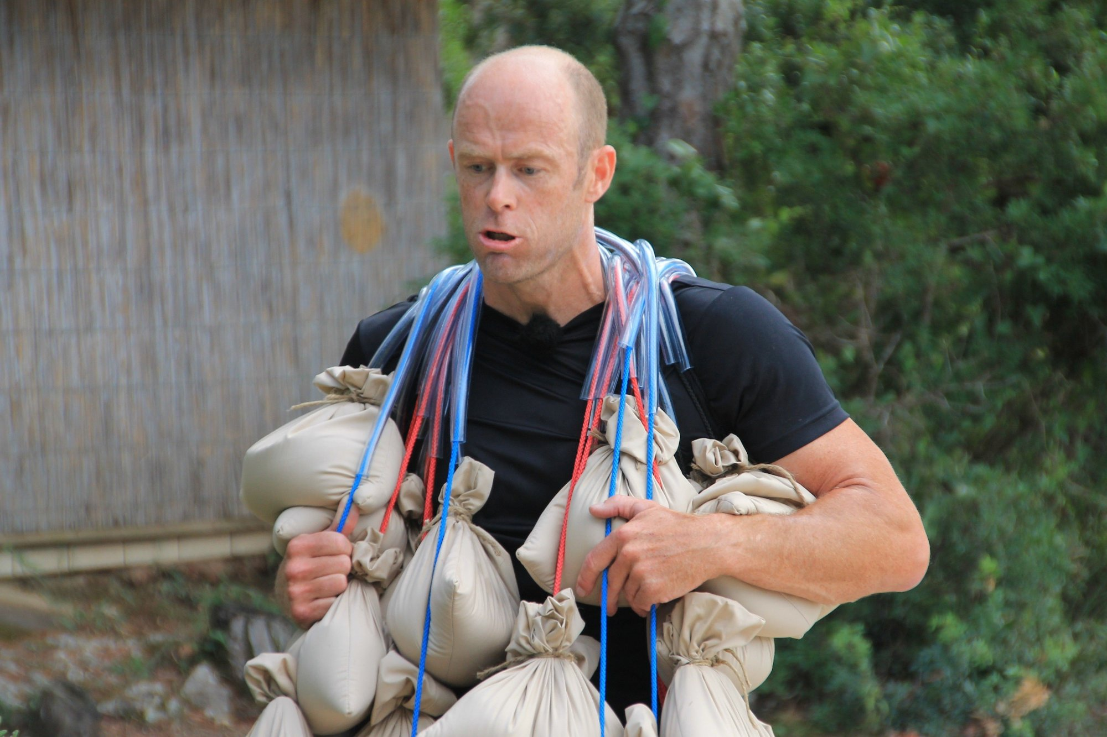
ACCUMULATED ASSUMPTION LOAD

Slide 219
« TECHNICAL DEBT »

Slide 220
THE INEVITABLE BYPRODUCT OF CHANGE AND INERTIA

Slide 221
CHANGE IMPACT

Slide 222
HOW LONG DOES THIS FEATURE TAKE TO IMPLEMENT?

Slide 223
HOW DOES THIS FEATURE CHANGE OUR MENTAL MODEL?

Slide 224
HOW MANY ASSUMPTIONS ARE INVALIDATED?

Slide 225
HOW MANY DECISIONS MUST BE UNDONE AND REMADE?

Slide 226
HOW MUCH STRUCTURE RELIES ON THE INVALIDATED ASSUMPTIONS?

Slide 227
HOW MUCH STRUCTURE RELIES ON THE DECISIONS THAT MUST BE UNDONE?

Slide 228
TECHNICAL STRUCTURE

Slide 229
ORGANIZATIONAL STRUCTURE

Slide 230
PSYCHOLOGICAL STRUCTURE

Slide 231
ECONOMIC STRUCTURE

Slide 232
INTERTWINED MUTUALLY REINFORCING STRUCTURES

Slide 233
ENTRENCHMENT

Slide 234
OSSIFICATION

Slide 235
CONFLICT
MISUNDERSTANDING
AMBIGUITY
GENERALIZATION
INDECISION
Assumption
Notes:
Unwitting assumption.
Some indecision about architecture
Bet against the future
Some ambiguity of domain terms
Misunderstanding between teams
Conflict of vision

Slide 236
CONFLICT
MISUNDERSTANDING
AMBIGUITY
GAME OVER
GENERALIZATION
INDECISION
Assumption

Slide 237
CAN WE SLOW IT DOWN?

Slide 238
CAN WE REVERSE IT?

Slide 239
CAN WE WIN?

Slide 240
WE CAN PLAY SUCCESSFULLY

Slide 241
START BY ACKNOWLEDGMENT

Slide 242
BEING EXPLICIT

Slide 243
MODELLING IS OUR BEST BET

Slide 244
MODELLING AS DELIBERATE DESIGN OF TECHNICAL CATEGORIES

Slide 245
MODELLING IS DIFFICULT

Slide 246
MODELLING IS META-PROGRAMMING

Slide 247
DISCOMFORT

Slide 248
RELUCTANCE

Slide 249
« WHY ARE YOU MAKING IT SO COMPLICATED? »

Slide 250
TO AVOID MAKING IT UNNECESSARILY COMPLICATED OVER TIME

Slide 251
MODELLING IS TEACHABLE

Slide 252
LEARN ABOUT CATEGORIES

Slide 253
👏
Notes:
And now, if you will.

